Slide 1
Rate Of Reaction

Slide 2
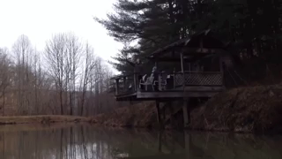
In this lesson we are going to look at:
1. | Understanding that the rate of a reaction can vary.
2. | Identifying the factors which affect the rate of a reaction.

Slide 3
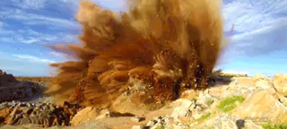
Some reactions happen very quickly.
For example, combustion can happen in seconds, causing an explosion!

Slide 4
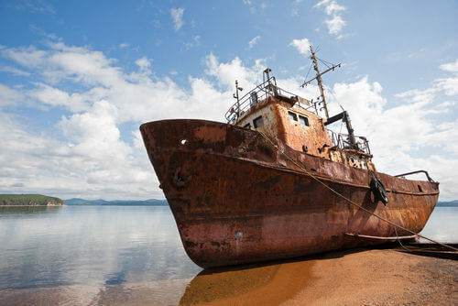
Some reactions happen very slowly.
For example, it can take months for rust to form on an old boat.

Slide 5
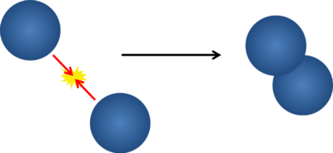
Reactions happen when particles interact - specifically, when they collide!
In a particle collision, electrons can be rearranged, depending on the energy involved in the collision. If the energy of a collision is high enough, the particles can break their bonds and reform as different substances.

Slide 6
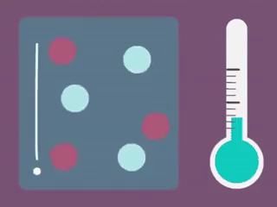
During a reaction, these collisions will be happening constantly as the reactants turn into the products.
This means that the time it takes for the reactants to fully react and turn into the products depends on how many collisions are taking place every second.
If there aren't many collisions, the reaction will be slow. If there are a lot, the reaction will be fast!

Slide 7
For a reaction to occur, we need two things to happen:
Reactants need to collide
and
The collision needs to be effective
If we want to change the rate of reaction, we can change either how many collisions occur, or how effective the collisions are.
An effective collision is one where both reactants have enough energy to react.

Slide 8
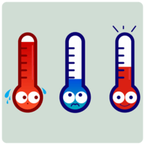
Almost every reaction can be sped up or slowed down.
These are the factors that can control the rate of a reaction:
Temperature
Concentration
Surface area
Agitation
Catalysts

Slide 9
